Slide 1
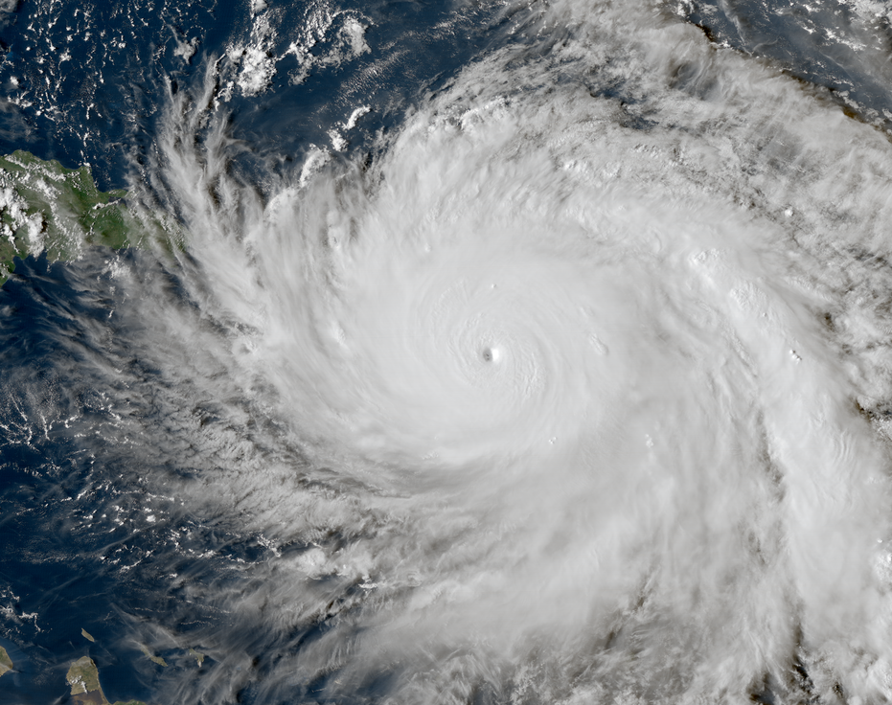
Challenges of Integrating Physical Exposure and Human Impacts Data in Tropical Cyclone Studies
Matthew Hughes, M.S. Graduate Student, Environmental Health – Epiodemiology
Brooke Anderson, PhD, Environmental Health – Epidemiology
Colorado State University, College of Veterinary Medicine and Biomedical Science

Slide 2
The Challenge: Spatial and Temporal Misalignment
Studying the effects that tropical cyclones have on communities requires using data on physical exposures (wind speed, precipitation, etc.) and human impacts (property damage, economic disruption, health effects, etc.)
Physical Exposures:
Large continentwide networks of weather monitors and sensors
Large spatial scales (entire continents)
Very fine (sometimes continuous) temporal scales
Human Impacts:
Administrative data sources, hospitalization records, vital records
Aggregated spatial scales (often based on political or administrative boundaries)
Temporal scales depend on impact being studied (hospitalization records are recorded by day, while pregnancies are recorded in weeks)

Slide 3
Spatial and Temporal Scales
Spatial Scales
Temporal Scales
Point Locations
Zip code/Parish/County
Metropolitan Area
State
Multi-state Region/Country
Seconds/Minutes/Hours
Day
Week
Cumulative Measures of Time

Slide 4
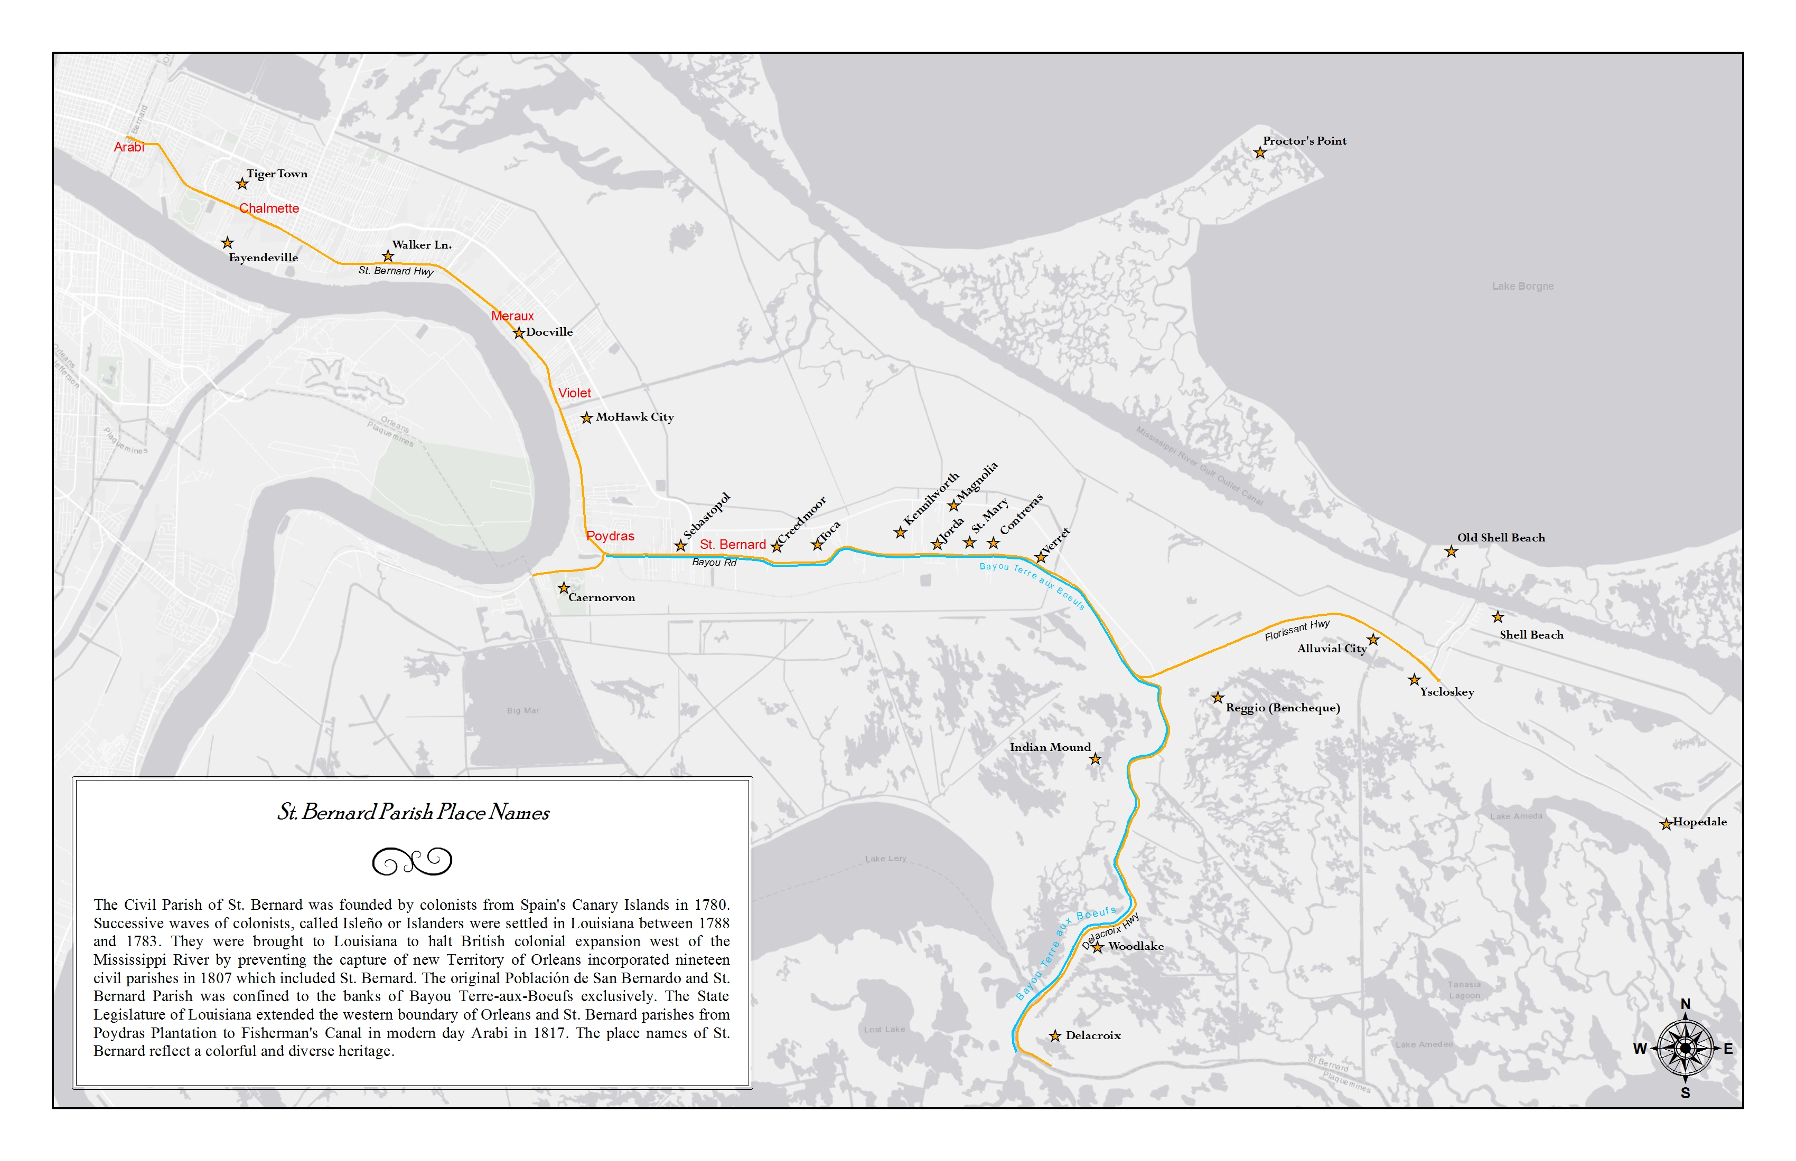
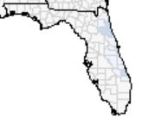
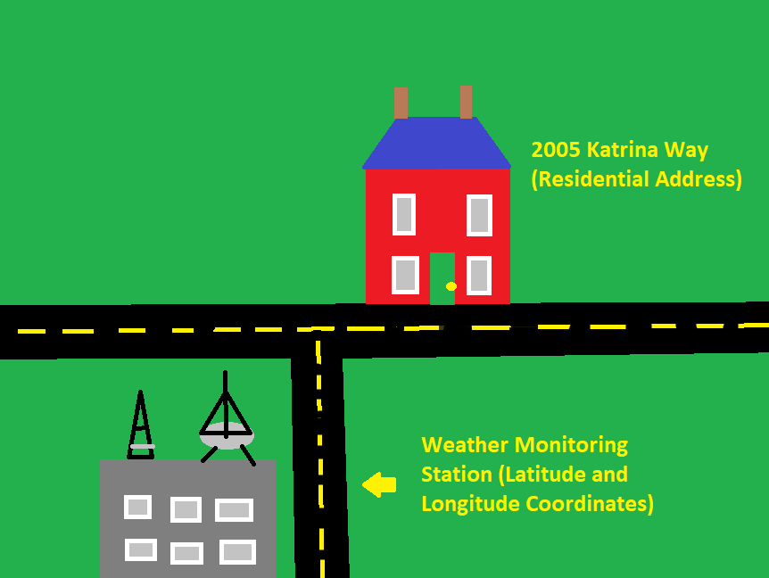
Point Location
Human Impacts Data – Residential Address, Hospital or Business address
Physical Exposure Data – Fixed monitors and sensors, weather stations, stream gauges give point location values of wind speed, precipitation, flooding, temperature, and pressure.
Zip Code/County/Parish
Human Impacts Data – Aggregated information on demographics and population
Physical Exposure Data – Aggregate exposure values (avg wind speed, total precip.) and binary exposure classification (exposed or unexposed)
State/Country
Human Impacts Data – Population totals (number of mortalities, birth defects)
Physical Exposure Data – Aggregated exposure values or estimated values from interpolating and modeling.

Slide 5
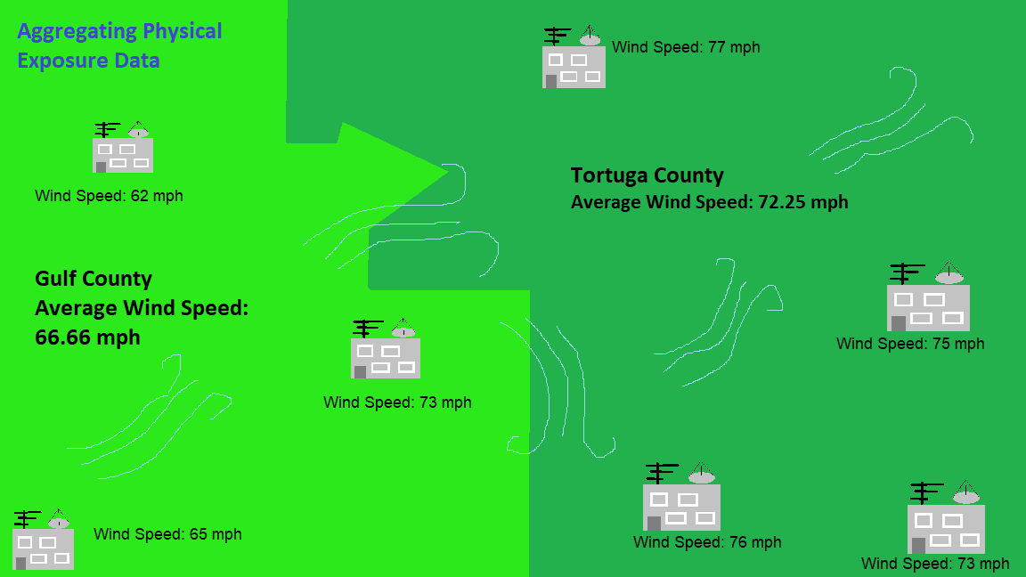

Slide 6
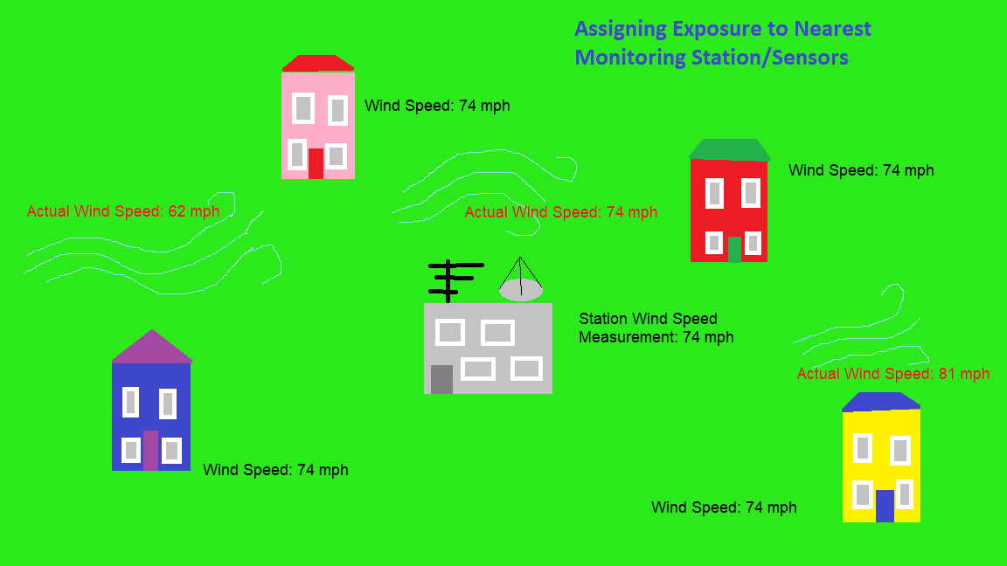

Slide 7
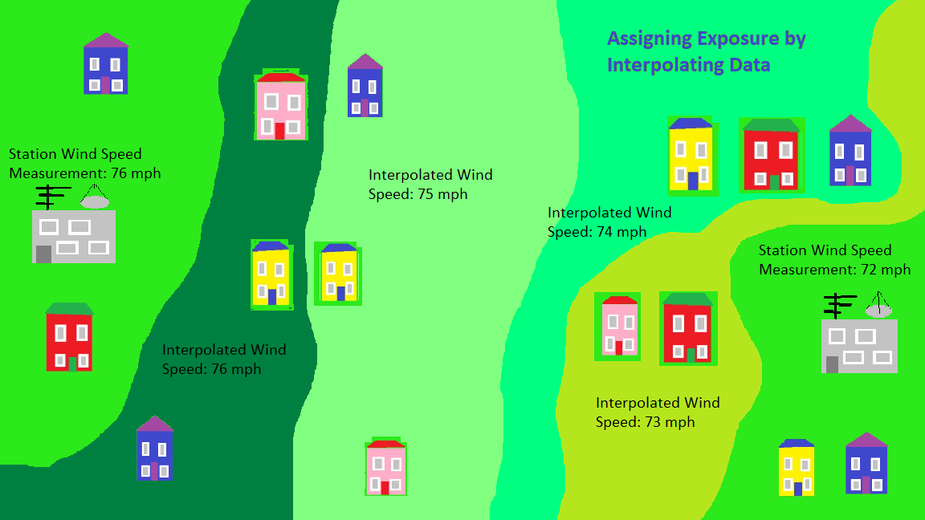

Slide 8
Implications of these Integration Methods
Ecological Bias
Loss of resolution when categorizing continuous variables
Misclassification

Slide 9
Questions
Looking at the aggregated spatial level of counties/parishes, what is the most reliable physical exposure for assigning exposure (precipitation, wind speed, etc.) . Or another way of putting things, which type of exposure will have the most homogeneity across a county/parish sized area and still be a good indicator of human impact?
What are the most common approaches to matching differing time scales? For example, much of the physical exposure data is at the temporal scale of seconds, minutes, hours. Human impacts are often assessed either after the storm, or during a cumulative measure of time (a storm season). Seems like the maximum wind speed, or maximum precipitation levels are used to do define cumulative time periods.

